Slide 1
Single Sign On
Renzo R. Wu

Slide 2
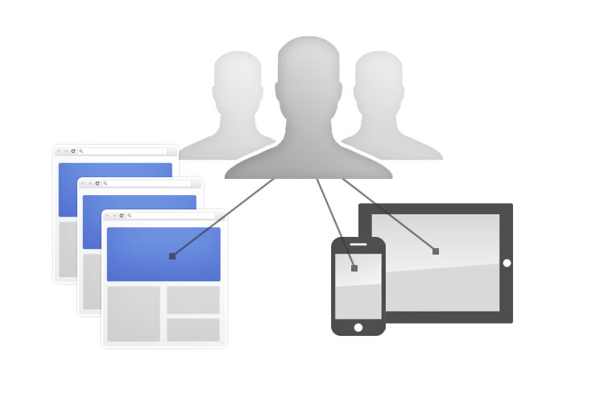
Definition
Single Sign On is an user authentication that allows user to access multiple applications with only using one set of login credentials.

Slide 3
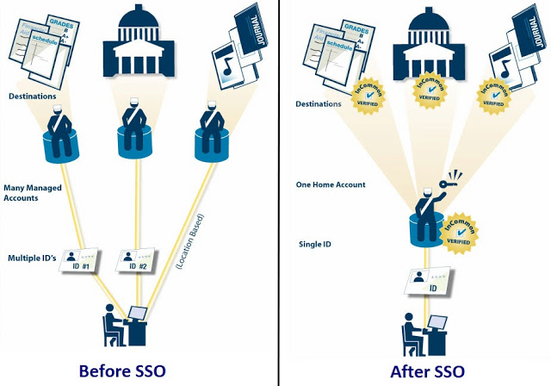
Purpose

Slide 4
Tutorial
renzowu3.github.io/sso/

Slide 5
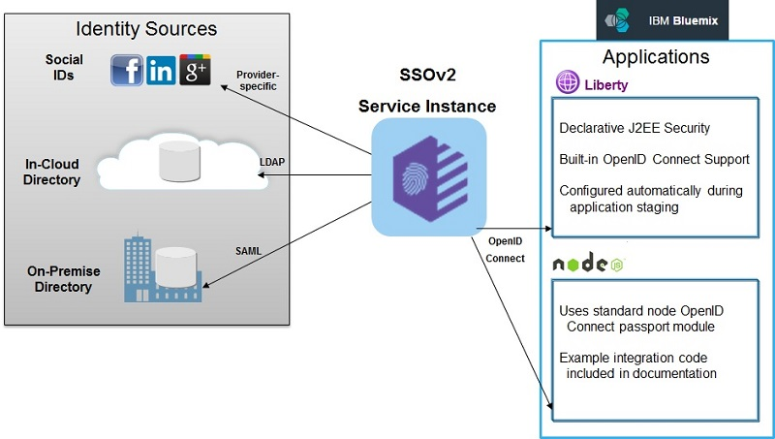
Overview

Slide 6
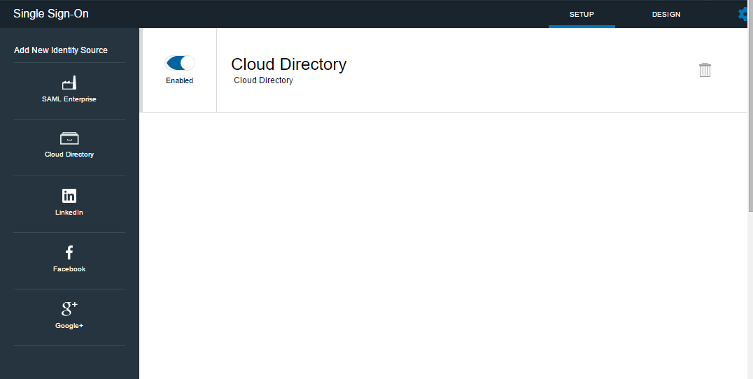
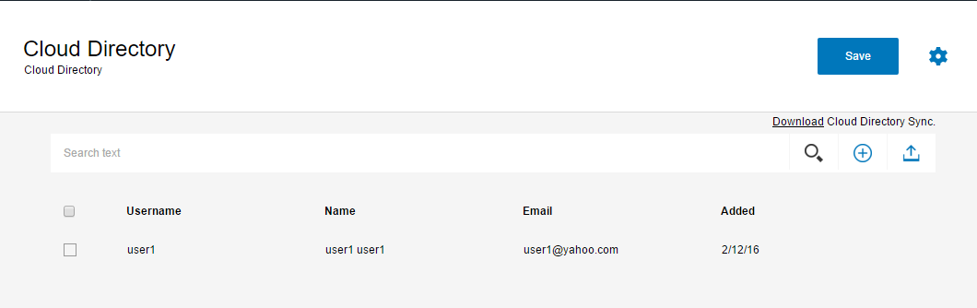
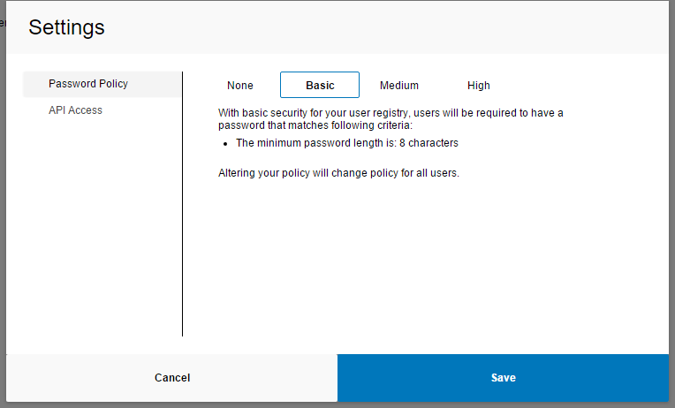
Cloud Directory

Slide 7
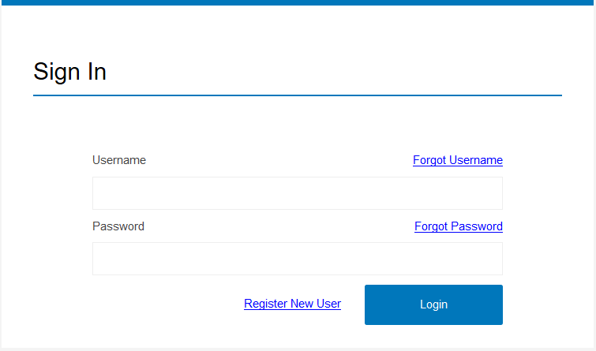
SSO login page

Slide 8
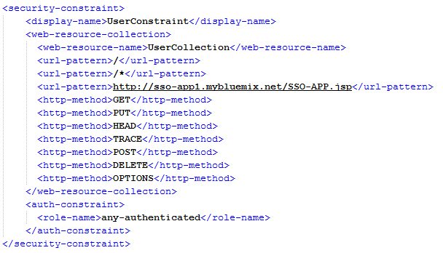
web.xml
Set security constraints

Slide 9
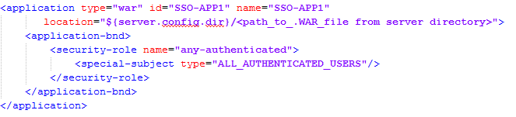
server.xml
Enable the security constraints

Slide 10
Single Sign On

